Slide 1
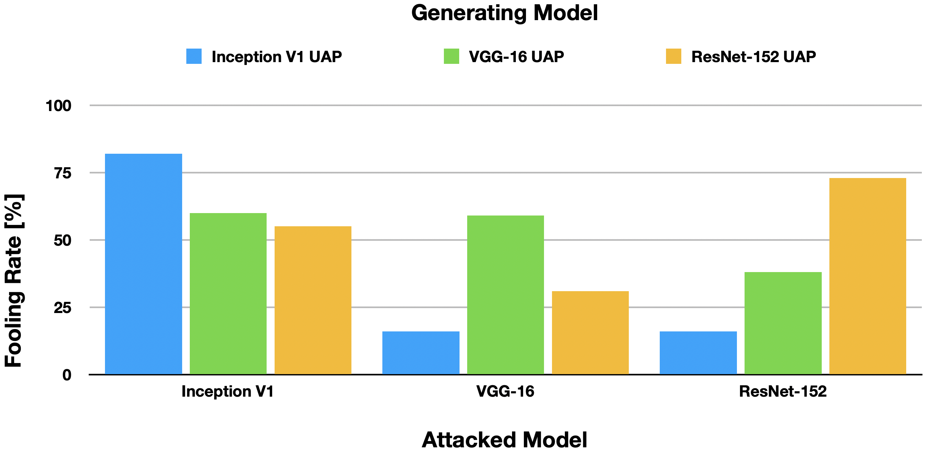
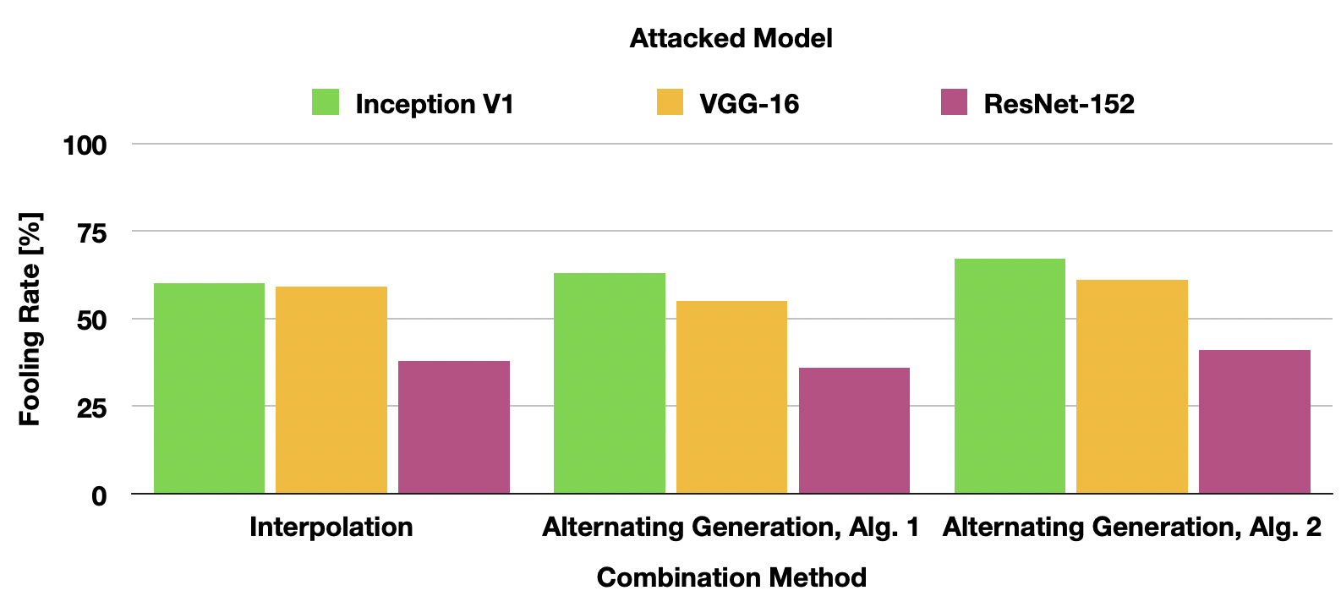
Combining Universal Adversarial Perturbations
Maurus Kühne (maurus.kuehne@students.ffhs.ch) Beat Tödtli (beat.toedtli@ost.ch)
Introduction
reproduction
Small perturbations in images can lead to misclassifications in image classifier models. The models are no longer able to correctly classify the image content. Universal perturbations exist that can be applied to an arbitrary image. Some of these universal perturbations also transfer well across different classifier models.
Implemented algorithm of Moosavi-Dezfooli et al. [1]
Created perturbations for 5 models with ImageNet data
Measured the fooling rate on the ImageNet validation set
We achieved similar fooling rates for VGG-F, Inception and ResNet-152 as reported in [1].
The perturbations look similar to perturbations in [1]
+
Fooling rates for VGG-16 and VGG-19 are about 20% below [1]
When transferred to other models, our fooling rates are about 20% below [1]
We generated a perturbation for each model and measured the fooling rate on all models.
car
backpack
Inception
VGG-16
VGG-19
VGG-F
ResNet-152
cat
paper towel
Beispiele von generierten Störwerten für die fünf getesteten Modelle
Example of a universal perturbation for the Inception model. The perturbation leads to misclassifications when applied to different images.
Combination methods
Motivation
We implemented three combination methods to increase transferrability
We tested all methods with Inception and VGG-16 models
Measured transferrability on ResNet-152
Can the fooling rate and transferrability measured by Moosavi-Dezfooli et al. [1] be reproduced?
Can we increate the transferrability of universal adversarial perturbations by combining perturbations or models during generation?
Alg. 2 results in high fooling rates for both models used for training
All tested methods couldn’t significantly increase the fooling rate on ResNet-152
The methods didn’t increase the fooling rates on Inception or VGG-16
Fooling rates measured on VGG-16, Inception and ResNet-152
[1] Moosavi-Dezfooli, et al. «Universal Adversarial Perturbations». In 2017 IEEE Conference on Computer Vision and Pattern Recognition (CVPR), 86–94, 2017.

